Slide 1
Erori de design
Planificarea Aplicțiilor Web

Slide 2
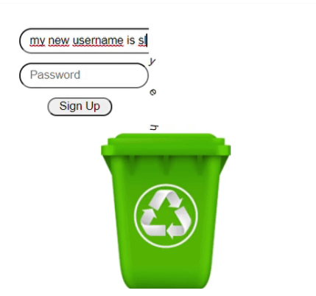
1
The best way to limit username size
https://github.com/GoulartNogueira/BadUI/blob/master/LimitUsernameSize

Slide 3
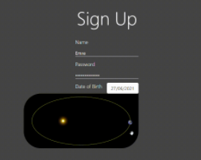
II
Scientific Date Picker
https://github.com/GoulartNogueira/BadUI/blob/master/ScientificDatePicker

Slide 4
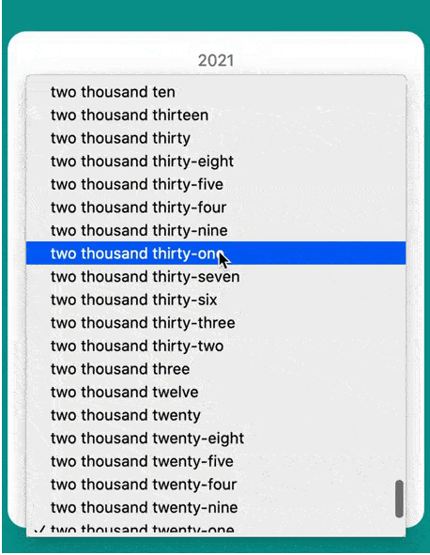
iii
Calendar Hell
https://github.com/GoulartNogueira/BadUI/blob/master/calendar-hell

Slide 5
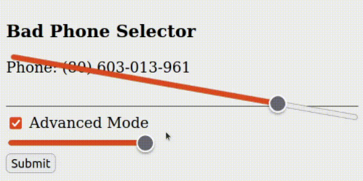
iv
Bad UI Battle
https://github.com/GoulartNogueira/BadUI/blob/master/Phone-Slider-Selector/BadUIPhone.html

Slide 6
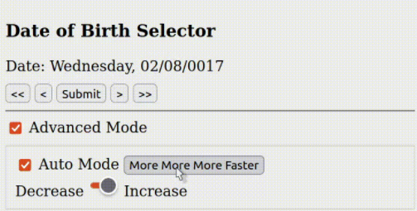
v
Bad UI Battle X2
https://github.com/GoulartNogueira/BadUI/blob/master/Date/BadUIDate.html

Slide 7
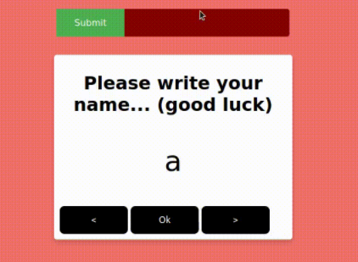
VI
Bad Name Selector
https://github.com/GoulartNogueira/BadUI/blob/master/calendar-hell

